Slide 1
The European Community after the Oil Crisis
Stagnation and reform – 1973 to 1992

Slide 2
The European Community (EC) and recession
The ECSC, EEC and EURATOM were amalgamated in the European Community (EC) on 1 July 1967, and the planned customs union was achieved ahead of schedule in 1968. De Gaulle resigned the French presidency in 1969. Following his resignation and the Luxembourg Compromise the European bandwagon started to roll again. The Hague Summit was held in December 1969. It was the idea of George Pompidou, de Gaulle's successor as French President. The Summit considered issues relating to the enlarging of membership of the Community, economic and monetary union, and progress in cooperation on technological and social policies, and also provided for more regular discussions between Foreign Ministers. Agreement to enlarge the Community was finally reached in June 1971, to take effect from 1 January 1973. It was the first enlargement the Community had undergone.

Slide 3
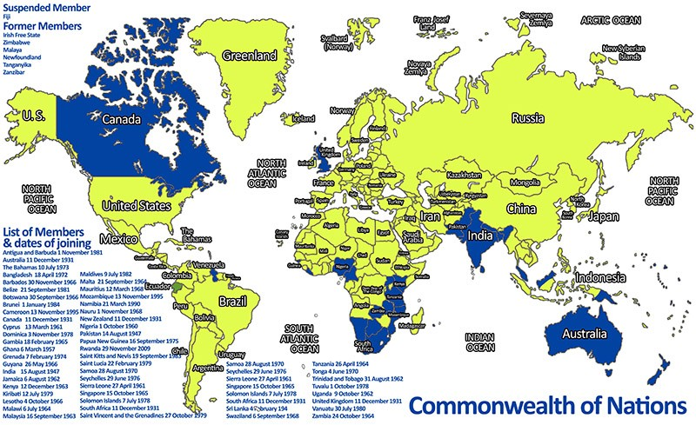
Various arrangements were made to ease the difficulties of the British Commonwealth, which exported food to Britain and would now be subject to a Community tariff. The new members were also granted special fisheries arrangements, necessary because a fisheries policy initiated at the same time gave all Community members equal and free access to each other’s waters. The new members all had extensive fishing fleets and would therefore suffer most from competition.

Slide 4
Norway did not join. A Norwegian referendum voted 53 per cent against joining, mainly due to concerns over Norway's fishing industry and its relationship with its Scandinavian neighbours. A Danish referendum voted 63 per cent in favour of membership. It was expected that Danish agriculture would benefit from the Common Agricultural Policy, and Denmark's chief export markets were Britain and Germany. An Irish referendum produced a positive result of 83 per cent; a logical outcome given that 70 per cent of Irish exports went to Britain. The expansion of the Community from six to nine members was expected to give it a new boost. Unfortunately, the enlargement took place just as the Community became embroiled in problems and economic recession. The 1973 Arab-Israeli War led to an Arab embargo on oil supplies and a four-fold increase in oil prices.

Slide 5
The 1973 Oil Crisis
The prosperity and industrial expansion of Europe after 1945 depended on cheap oil supplies. The economic advantage of oil was simple. Between 1950 and 1973, the average price of a barrel of oil was two dollars. By 1972, oil provided 65 per cent of Western Europe's electricity, while coal accounted for only 22 per cent. The plentiful supply of oil before 1973 kept prices low, as new entrants into the oil-producing business charged low prices. African countries supplied 6 per cent of Europe's oil in 1960, but over 40 per cent in 1970.

Slide 6
Some of the world’s most important oil producing states were ‘Third World’ states that had recently become independent as a result of decolonisation. The emergence of a radical Arab leadership during the 1950s and in the 1960s upset the traditional arrangements with the oil companies. Many Arab leaders in newly independent countries such as Kuwait understood the importance of oil to the Western countries. In September 1960, Saudi Arabia, Iran, Iraq, Kuwait and Venezuela set up the Organization of Petroleum Exporting Countries (OPEC) in Baghdad. OPEC changed the oil business forever. OPEC's ultimate aim was to get control of the oil fields away from the oil companies in order to increase OPEC's financial return from the sale of oil. By 1973, most of the oil-producing countries had taken control of their oil resources, either through nationalisation (as in Iran, Libya and Iraq) or through new contracts with the oil companies. In October 1973 OPEC decided to set and control the price of oil on its own without negotiating with the oil companies.

Slide 7
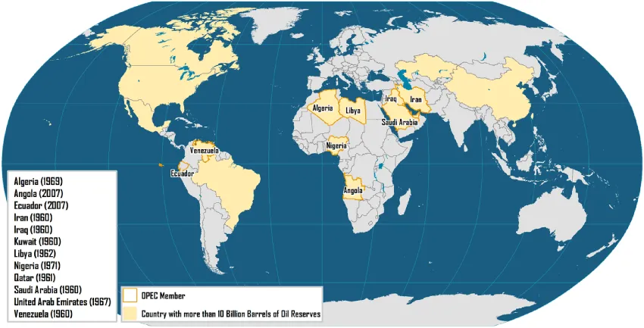

Slide 8
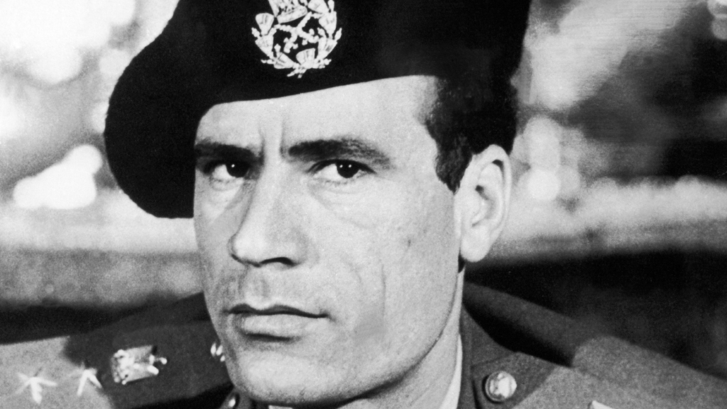
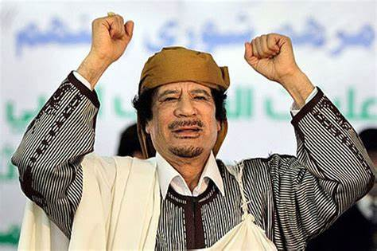
Colonel Muammar Gaddafi (1942- 2011)
Colonel Muammar Gaddafi (1942- 2011) A Libyan soldier, he overthrew King Idris in 1969. He promoted himself to colonel, the highest rank in the Libyan army. He supported violent revolutionaries in other parts of the world, including the IRA. In 1986 the US bombed Libya in an attempt to kill him. He died in the civil war that followed the Arab Spring of 2011.

Slide 9
This strategy coincided with a political crisis. On 6 October 1973 the Arab-Israeli War started when President Sadat of Egypt invaded Israeli territory. A ceasefire was agreed in November after an Israeli victory. OPEC decided to use the oil weapon against countries that supported Israel. No OPEC country was to send oil to the USA or the Netherlands. Countries friendly to the Arab cause would receive their usual amount of oil. The oil trade was thrown into chaos by the OPEC decision. The immediate shock to the oil market did not produce the anticipated change in the American attitude towards Israel.

Slide 10
Short-term consequences
The oil crisis revealed the over dependency of Europeans on cheap oil but also showed the weakness of the EEC. The EEC leaders failed to agree in December 1973 on the 'pooling' of oil among countries. It was left to individual countries to decide on the measures that they should adopt to save energy. Countries began to restrict the industrial and consumer use of oil. Individual consumers found it hard to obtain oil for home heating or for car use. Prices escalated. Oil producers saw their revenues soar. Consumers were prepared to pay any price, and the auction market saw a tripling of prices in some cases. A mild winter and a fall in demand for oil lessened the impact of the crisis during the winter of 1973-1974. Governments gave any available oil supplies to essential services, such as electricity stations and hospitals. Governments ran intensive publicity campaigns, showing ways in which the consumers could save energy. Belgium and the Netherlands decided to ban Sunday driving. Belgium cancelled its national car rally. Luxembourg closed petrol stations on Saturdays and Sundays. Denmark lowered speed limits, while France asked offices to lower their central heating by two degrees.

Slide 11
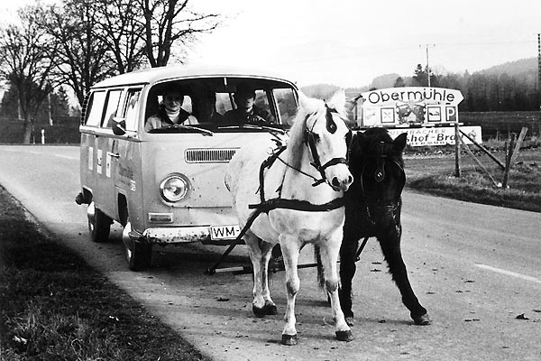

Slide 12
Long-term consequences
When the flow of cheap, imported oil dried up, the swift increase in oil prices led to stagflation. The industrialised economies soon learned the meaning of recession: high inflation and high unemployment. Oil companies passed the increased costs on to consumers. Countries produced less, exported less and ran up high trade deficits. The oil crisis brought an end to the 'Golden Age’ of economic growth in Western Europe. After the 1973 oil crisis the main oil companies started to invest in new oil fields, such as the North Sea. The oilconsuming countries looked elsewhere for supplies. They used non-OPEC countries, such as Mexico and the USSR, to meet their oil needs. The 1973 oil crisis forced the oil-consuming countries to change their dependence on oil. Countries without oil, such as France turned to alternatives such as nuclear power. Others, such as the UK, turned to natural gas. Iceland used its geothermal resources of energy to replace oil. High local taxes on oil in most European countries also encouraged consumers to cut down on their consumption of oil.

Slide 13
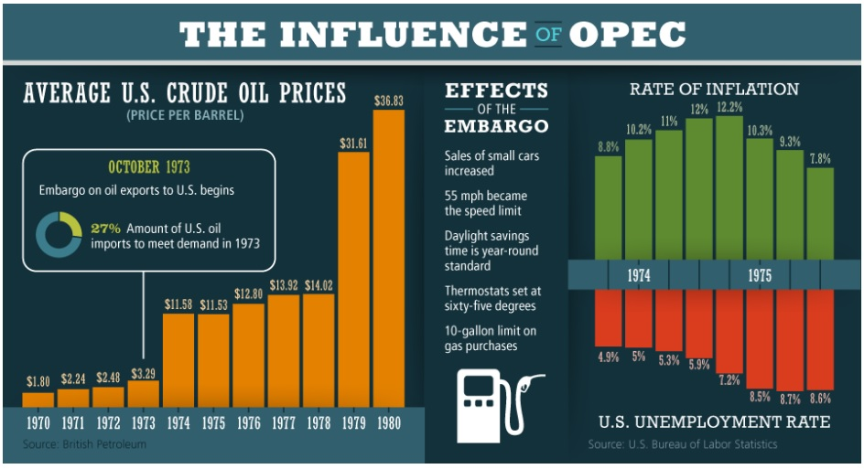

Slide 14
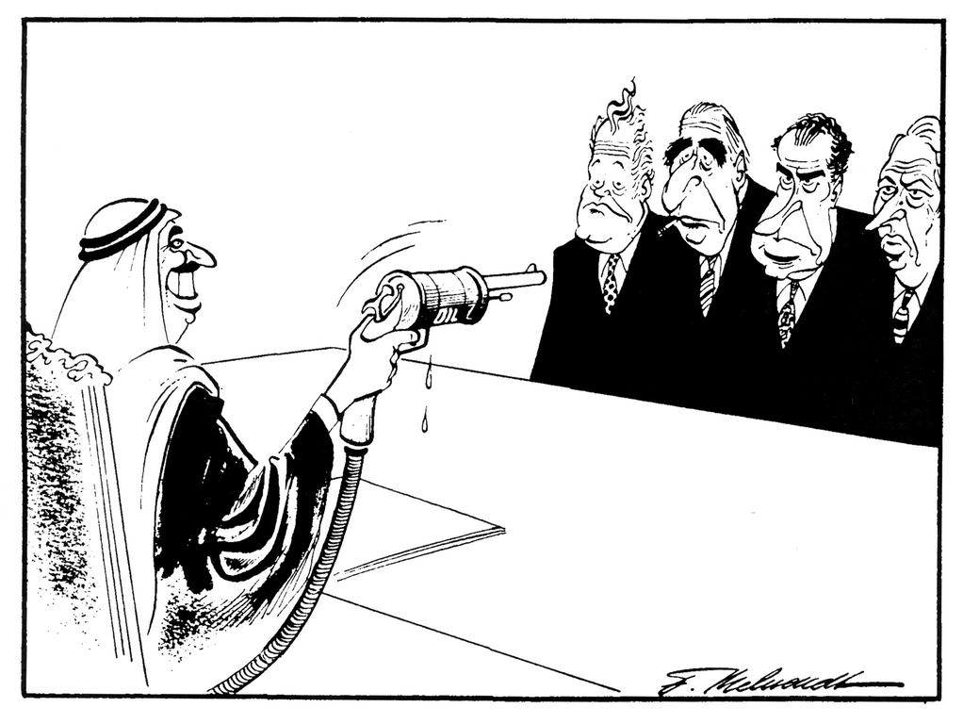

Slide 15
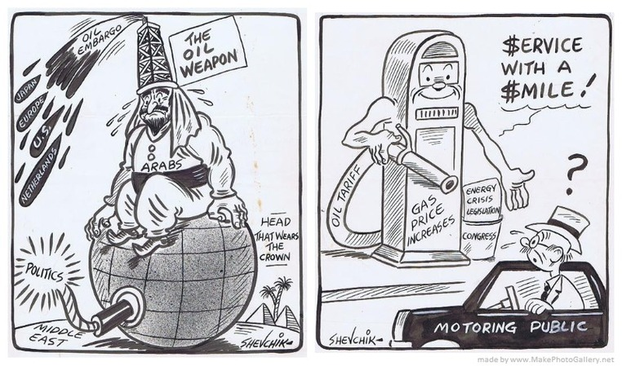

Slide 16
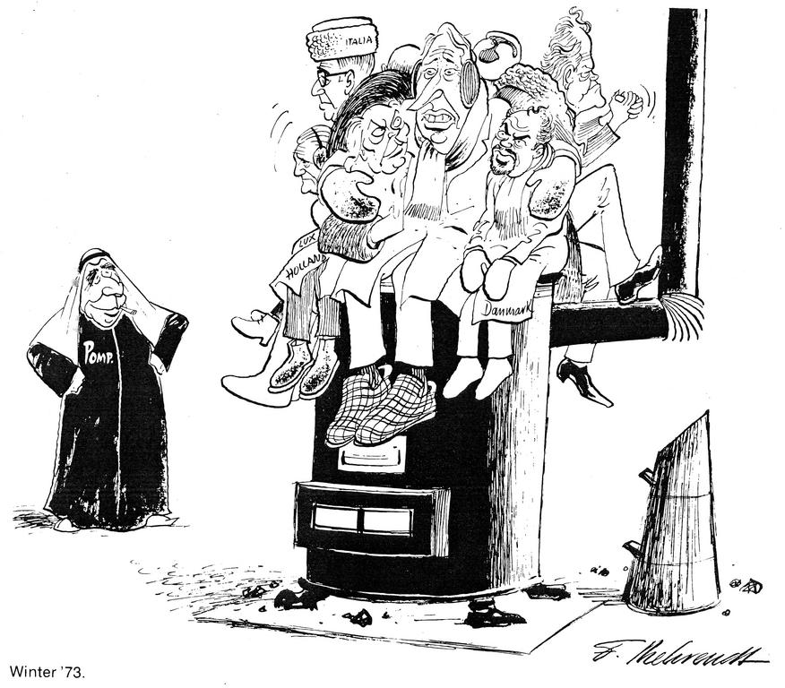

Slide 17
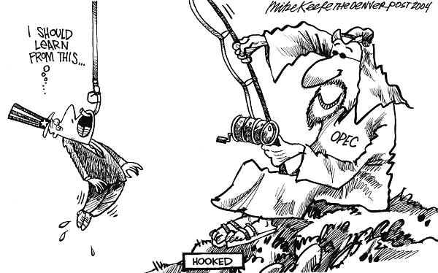

Slide 18
Activities
1. What was the Treaty of Rome intended to achieve?
2. Explain the function and relative importance in the 1960s of the European Commission, Council of Ministers and the Parliamentary Assembly.
3. Why was the purpose of the C.A.P. and why was it controversial?
4. Explain the difference between intergovernmentalism and supranationalism?
5. Why was the European project stalled for much of 1960s and how did it get going again?
6. What were the main causes and consequences of the 1973 oil crisis?

